Slide 1
SyllaView:
Get Organized
David Mejia, Myron Rios, Alberto Mejia

Slide 2
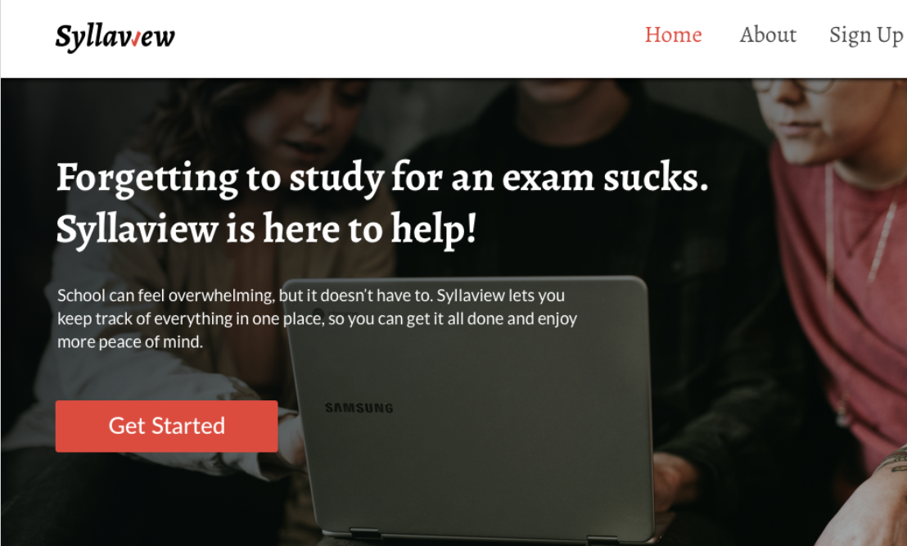
What our project is
Overview
Why we choose this project
Progress Made
Demo
Next Steps
Questions
Agenda

Slide 3
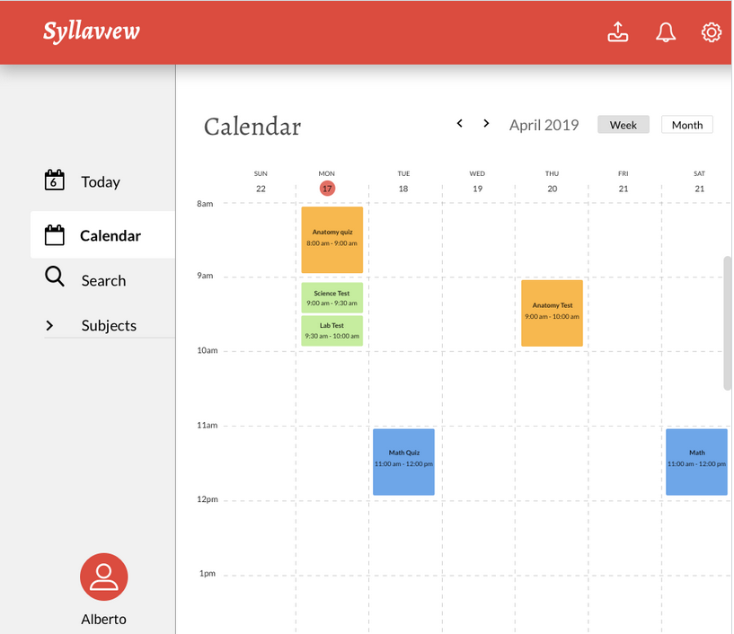



What is SyllaView
Syllaview is a web-based application that populates your calendar with upcoming deadlines and activities.
Django 2 is used as the framework
SQLite is used to store user and their info
A mix of HTML, CS, JavaScript and BootStrap used for the front end

Slide 4
Overview
Expected delivery
1 more RCOS semester
Recent progress
Added Login and Registration feature
Added calendar viewing feature
Biggest risk
Parsing algorithm was found to be too complex to implement in a general case

Slide 5
Why we chose this project
Wanted to expand web development knowledge
Not much competition
Increase of information in today’s world
A clear vision was in place from the beginning

Slide 6
Progress Made
Website is developed and can be run locally
Database made to store user information
Some functionality to store other data
Calendar is viewable with some simple parsing
Tested website functionality on multiple users

Slide 7
DEMO

Slide 8
Next steps
Assignment 1
Create a general parser for various kinds of syllabi
Assignment 2
Make the website mobile friendly
Assignment 3
Upgrade to current versions of technology used

Slide 9
QUESTIONS

